Slide 1
SECURE DATA HIDING IN IMAGES USING STEGANOGRAPHY
CAPSTONE PROJECT
Presented By:
Student Name : D ABHISHEK YADAV
College Name & Department : VARDHAMAN COLLEGE OF ENGINEERING ( COMPUTER SCIENCE AND ENGINEERING )

Slide 2
OUTLINE
Problem Statement
Technology used
Wow factor
End users
Result
Conclusion
Git-hub Link
Future scope

Slide 3
Problem Statement
There is a critical need for a secure method to hide and protect confidential messages within digital images. Traditional encryption methods are not sufficient. The challenge is to create a web-based application that uses advanced encryption and steganography to securely encrypt and decrypt messages within images, ensuring only authorized access.

Slide 4
Technology used
LIBRARIES :
Frontend
HTML: Markup language for creating the structure of the web pages.
CSS (Tailwind CSS): Utility-first CSS framework for designing responsive and modern user interfaces.
TypeScript: Superset of JavaScript that adds static types for better code quality and maintainability.
React: JavaScript library for building user interfaces, enabling the creation of reusable UI components.
Vite: Next-generation frontend tooling for fast development and build processes.
Backend
Python: High-level programming language used for server-side logic.
Flask: Lightweight WSGI web application framework for Python, used to build the backend server.
Pillow: Python Imaging Library (PIL) fork, used for opening, manipulating, and saving image files.
OpenCV: Library of programming functions mainly aimed at real-time computer vision, used for advanced image processing tasks. PLATFORMS :
VS CODE
GITHUB

Slide 5
Wow factors
Unique features What makes this project stand out from other projects are its unique features and robust technology stack:
Advanced Encryption and Decryption: The project uses state-of-the-art encryption algorithms to securely hide and retrieve messages within images, ensuring maximum data protection.
Password Protection: Incorrect passwords generate random characters and symbols, adding an extra layer of security by safeguarding against unauthorized access.
Multi-Technology Integration: Combines the power of HTML, CSS (Tailwind CSS), TypeScript, React, Vite for the frontend, and Python (Flask), Pillow for the backend, creating a seamless and efficient user experience.
User-Friendly Interface: Built with React, the application offers an intuitive and responsive interface, making it easy for users to encrypt and decrypt messages.
Future-Ready Enhancements: Plans for multi-language support, advanced encryption algorithms, and a mobile application ensure that the project remains relevant and useful in the future.
Educational Value: As part of the IBM Cyber Security Internship, this project not only provides practical solutions but also serves as an educational tool for learning about cybersecurity and steganography.
These features collectively make the project a standout in the field of secure data hiding and encryption.

Slide 6
End users
Media and Journalism: Journalists needing to protect sensitive information.
Corporate and Business: Corporate employees sharing confidential business data.
Government and Law Enforcement: Government officials handling classified information.
Healthcare: Healthcare professionals safeguarding patient records.
Legal: Legal professionals protecting client confidentiality.
Education: Researchers and academics working with sensitive information.
Financial Institutions: Financial institutions accessing secure communications.
Non-Profit Organizations: Non-profit organizations protecting donor information.
IT and Cybersecurity: IT administrators ensuring data security within an organization.
Individuals: Individuals wanting to secure personal messages or data.

Slide 7
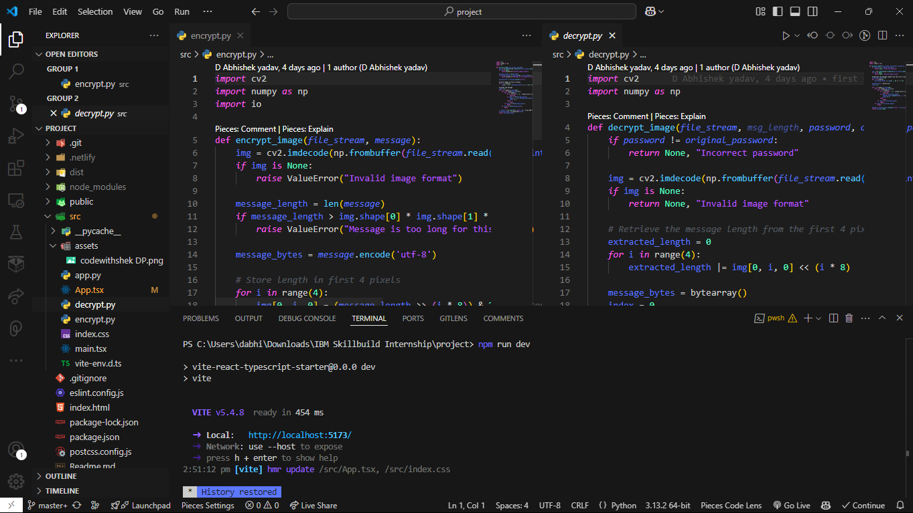
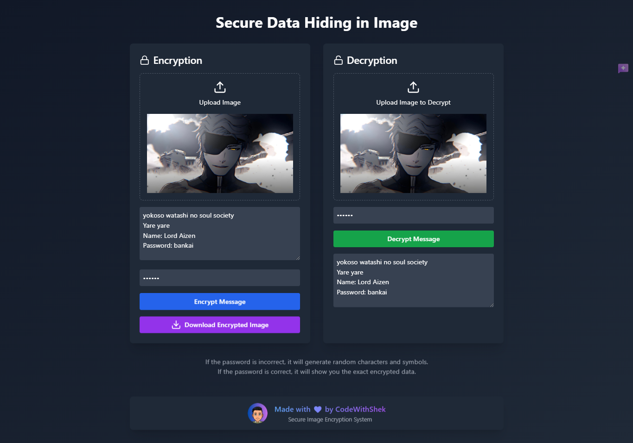
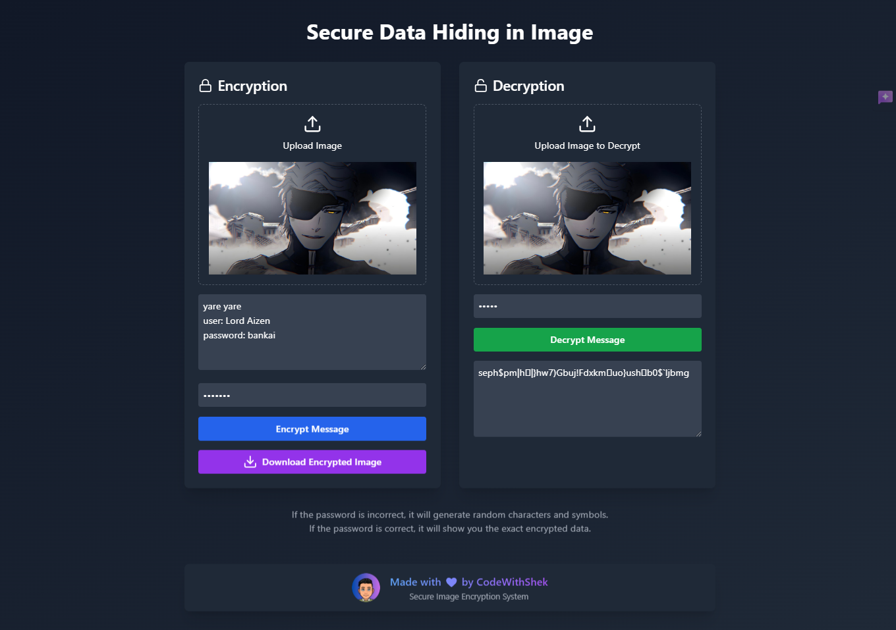
Results
CODE
CORRCT OUTPUT ON CORRECT PASSWORD
WRONG OUTPUT ON WRONG PASSWORD

Slide 8
Conclusion
In conclusion, the IBM-Intern-Secure-Data-Hiding-in-Image-Using-Steganography project successfully addresses the critical need for secure data transmission in our increasingly digital world. By leveraging advanced technologies such as HTML, CSS (Tailwind CSS), TypeScript, React, Vite, Python (Flask), and Pillow, this web application provides a robust solution for encrypting and decrypting messages hidden within images. The implementation of steganography ensures that sensitive information remains confidential and protected from unauthorized access. This project not only demonstrates the potential of combining modern web development frameworks with cybersecurity principles but also sets the stage for future enhancements, including multi-language support, advanced encryption algorithms, and mobile application development. Through this initiative, we have taken a significant step towards safeguarding digital communication and ensuring privacy in the digital age.

Slide 9
GitHub Link
Live Website URL: https://ibm-intern-encrypt-and-decrypt-images.netlify.app/
GitHub Repository URL: https://github.com/codewithshek/IBM-Intern-Secure-Data-Hiding-in-Image/

Slide 10
Future scope
✅ Implement multi-language support.
✅ Add advanced encryption algorithms for enhanced security.
✅ Develop a mobile application for on-the-go encryption and decryption.
✅ Integrate cloud storage options for secure data backup and retrieval.
✅ Enhance user interface for a more intuitive and seamless experience.
✅ Implement real-time collaboration features for team-based encryption and decryption tasks.
✅ Add support for various image formats to increase compatibility and flexibility.
✅ Develop a browser extension for quick and easy access to encryption and decryption tools.

Slide 11
THANK YOU

